Slide 1
Lipidomics data processing v4 (lipidExploreR)
2024-09-04
LGW

Slide 2
Overview
V4 consists of an R notebook with 2x fixed chunks
The operator/user is required to run through each chunk in sequence
Running through the chunks is interactive – directing the user towards data location, and producing fixed data outputs for consistency
V4 notebook is found here:
https://github.com/lukewhiley/targeted_lipid_exploreR/blob/main/v4/notebooks/lipid_exploreR_notebook_v4.Rmd

Slide 3
Chunk 1 - skylineR
Peak integration is performed by skyline
There are ~1200 peaks to evaluate per sample
It is not feasible for manual review of projects
Chunk 1 attempts to standardize integrations for consistency

Slide 4
Chunk 1 – skylineR operations
SkylineR operations:
Set up list structure in r
Set project metrics –
Project location; username; lipid method (v1/v2); qc type (ltr/pqc)
Set up folder structure for consistent data input and export
Read in mzml files
Use mzml actual MRM data (LTR samples only) to find:
Peak apex (e.g.to find peak RT)
Peak boundaries (to set consistent integration windows
This creates optimised skyline integrations for consistent integrations
Note: there are weaknesses to this approach – e.g. isomeric selection, BUT, we do not run individual standards so this is overall assay weakness. This approach seeks for consistent integrations.

Slide 5
Chunk 1 - skylineR
Final output is an .rda file containing a “master_list”:
mzml file data
Skyline optimized files
Skyline integrals
Note: it is currently recommended that skyline is performed per plate for maximum integration consistency in cases where RT may subtly move between plate runs.

Slide 6
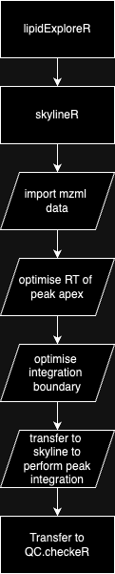
Process Flow skylineR

Slide 7
Chunk 2 - qcCheckR
Following completion of skylineR, qc checks are required.
Chunk 2 relies on completion of the skylineR per plate and requires the “master_list” format to operate.
It should be commenced from scratch following completion of skylineR for each plate

Slide 8
Chunk 2 – qcCheckR operations Set-up
Load .rda files containing “master_list” format from each skylineR iteration on each plate of samples
Load templates and guides (e.g. internal standard guides)

Slide 9
Chunk 2 – qcCheckR operations Phase 1: data preparation
Transpose skyline data export to “metabolomics format” (samples in rows, features in columns) and add acquisition metadata
Sort in actual acquisition order (uses mzml data timestamp)
Impute missing values
Signal drift and plate/batch corrections on peakArea data using stat target algorithm
Calculate peakAreaResponse
Calculate concentration
Note – operations 5+6 are performed for all peakAreaData [raw, imputed and statTarget]

Slide 10
Chunk 2 – qcCheckR operations Phase 2: filtering/flagging
Note: in data flagging – a missing value also includes samples <LOD with a peakArea <5000. This is considered noise.
Flag the samples that have >50% missing values. This indicates an error with extraction, injection, or sample
Flag the lipids with > 50% missing values
Flag the lipids with %RSD in LTR >30%

Slide 11
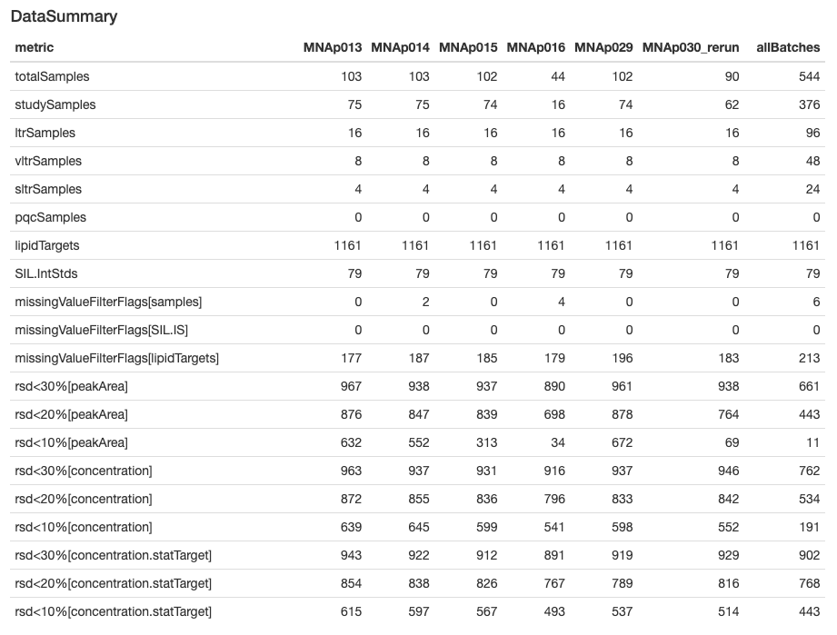
Chunk 2 – qcCheckR operations Phase 3: create summary report
Creation of a summary report of data

Slide 12
Chunk 2 – qcCheckR operations Phase 4: exports
Multitab Xlsx file
userGuide
QC.plate performance
QC.sampleMissingValues
QC.lipidMissingValues
QC.lipidRSD
Data.PeakArea (peakArea data for all samples and lipids. No imputation. No filters)
Data.silPeakArea
Data.allConcentration (conc. Values for all samples and lipids. No imputation. No filters)
Data.concentration.preProcessed (conc. Values. Yes imputation. Yes filters)
Data.statTarget.preProcessed (statTarget. conc. Values. Yes imputation. Yes filters)

Slide 13
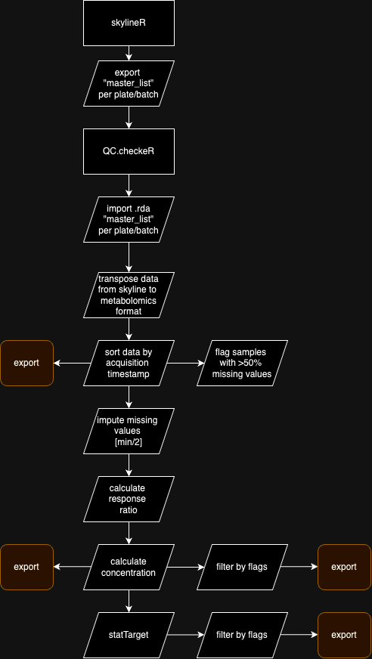
Process Flow qc.checkeR

